Slide 1
Switch-gear and Protection Unit - I

Slide 2
NATURE AND CAUSES OF FAULTS
Natural Disturbances:
Generators, transformers and other protective switchgear may fail due to insulation breakdown caused by natural disturbances like-
Lightning
High Speed Winds
Earthquakes
Earth Tremors
Snow/frost etc.
Accidental Causes:
Accidental faults such as falling of a tree along the lines, vehicles colliding with supporting structure, airplane colliding with lines may also occur.
Birds:
Birds may cause faults on overhead lines if their bodies touch one of the phases and the earth wire (or the metallic support structure which is at earth potential).

Slide 3
Accumulation of Dirt, Dust & Smoke etc. on insulator surface in polluted areas may also result in a fault.
Wind and Ice loading may cause insulator strings to fail mechanically.
Deterioration of insulation due to ageing and overloading of underground cables results in short circuits.
Some small animals like rats, lizards enter switchgear to create faults.

Slide 4
ELEMENTS OF SWITCHGEAR
Switchgear in general consists of the following:
Switches
Fuses
Circuit Breakers
Isolators
Relays
Control Panels
Metering Panels
Lightning Arresters
Current Transformers
Potential Transformers

Slide 5
FUNCTIONS OF SWITCHGEAR
To localize the effects of faults by operation of protective equipment and so automatically disconnect faulty point from the system.
To break efficiently short circuits without giving rise to dangerous conditions.
To facilitate redistribution of loads, inspection and necessary maintenance on the system

Slide 6
EFFECTS OF FAULTS
At the fault point itself there may be arcing, accompanied by high temp., fire and explosion.
Large voltages may be generated which may stress the insulation beyond their breakdown value.
Large currents may be produced which may overheat the power system components.
Large destructive mechanical forces may be developed due to very high currents.
Faults can cause the three-phase system to become unbalanced with the result that the three-phase equipment operates improperly.
Faults can cause system to become unstable and out of synchronism.
Sometimes faults blocks the flow of power.

Slide 7
OBJECTIVES OF POWER SYSTEM PROTECTION
To detect the fault and to disconnect the faulty section as fast as possible.
The normal operation of the rest of the system should not be affected.
Since many faults are self clearing, the system should be restored to its original configuration as rapidly as possible.
The normal and abnormal conditions should be clearly discriminated so that protective devices do not operate unnecessarily.

Slide 8
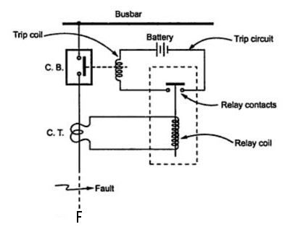
SIMPLIFIED OPERATION OF RELAY AND CIRCUIT BREAKER

Slide 9
ESSENTIAL QUALITIES OF PROTECTION

Slide 10
ESSENTIAL QUALITIES OF PROTECTION
Selectivity or Discrimination
Reliability
Sensitivity
Stability
Fast Operation

Slide 11
SELECTIVITY OR DISCRIMINATION
Ability to discriminate between a fault and normal condition.
The relay should also have the ability to distinguish whether fault lies within its zone of protection or outside.
The protective relay should have ability to distinguish between a fault and transient conditions like power surge.

Slide 12
RELIABILITY
A protective system must operate reliabily for fault occurring in its zone.
All protective system components like relay, CB, PT or CT, wiring, battery etc. must have high reliability.
Typical value of 95% or above is desirable.

Slide 13
SENSITIVITY
Protective relay should operate when current exceeds the present value (called pick-up current).
Should not operate below pick-up value.
Should operate just above pick-up value.

Slide 14
STABILITY
Protective system should remain stable even when large current is flowing through its protective zone due to external fault.
The concerned Circuit Breaker is supposed to clear the fault.
However, if that Circuit Breaker fails, after a preset delay, this relay will operate to trip the Circuit Break.

Slide 15
FAST OPERATION
Protection relays must be quick acting due to following reasons:
Critical clearing time should not be exceeded.
Electrical apparatus/appliances may get damaged due to high fault currents for long time.
A persistent fault will lower the voltage resulting in crawling and overloading of industrial drives.
A typical operating time of a protective relay is usually one cycle.

Slide 16
PRIMARY AND BACK-UP PROTECTION

Slide 17
PRIMARY AND BACK-UP PROTECTION
Power System is divided into zones for protection.
There is protective scheme for each zone.
Primary Relay:
Primary relay is first line of defence.
It is supposed to function first to isolate the fault.
Back-up Relay:
If due to any reason, the primary relay fails to operate there is back-up scheme.
This is second line of defence.

Slide 18
BACK-UP RELAYS
Remote Back-up
Relay Back-up
Breaker Back-up

Slide 19
REMOTE BACK-UP
Back-up relay located at neighbouring station.
These back-up entire primary protective scheme.
It is the cheapest and simplest form back-up pro.
It is most widely used for transmission lines.
It will not fail due to factors causing failure of primary protection.

Slide 20
RELAY BACK-UP
It is locally provided additional relay.
If primary relay fails, it trips same CB.
This operation is instantaneously.
For these relays, principles of operation is desirable to be different with those of primary.
These are recommended where a Remote-back-up is not possible.

Slide 21
BREAKER BACK-UP
This is also local back-up.
Preferred for a bus bar system where no. of CBs are connected to it.
When protective relay operates but CB fails, it becomes bus bar fault.
It becomes necessary that all CBs should trip.
After a time delay, the main relay closes the contact of a back-up relay which trips all other CBs on the bus if proper breaker does not trip within a specified time.

Slide 22
PROTECTION ZONES

Slide 23
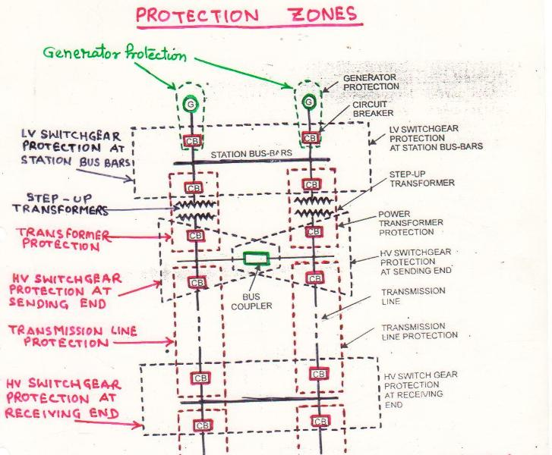
PROTECTION ZONES

Slide 24
In order to provide selectivity entire system is divided into several protection zones.
When the fault occurs in a given zone, then only the circuit breakers within that zone will be opened isolating the faulty elements and without disturbing rest of the system.
A part of the system protected by a certain protective scheme is called PROTECTIVE ZONE.
The entire power system is covered by several protective zones and no part of the system is left unprotected.

Slide 25
OVERLAPPING
Certain amount of overlapping between the adjacent protection zone is arranged.
For failures within the region where two adjacent protective zones overlap, more breakers will be tripped than the minimum necessary to disconnect the faulty portion.
But, if there were no overlap, a failure in a region between zones would not lie in either zone and therefore no breaker would be tripped.
The overlap is the lesser evil and preferred.
The extent of overlap is relatively small. The probability of failure in this region is low. Consequently, the tripping of too many breakers will not be frequent.

Slide 26
EARTHING

Slide 27
Concept of Earthing Systems
All the people living or working in residential, commercial and industrial installations, particularly the operators and personnel who are in close operation and contact with electrical systems and machineries, should essentially be protected against possible electrocution.
To achieve this protection, earthing system of an installation is defined, designed and installed according to the standard requirements.

Slide 28
What Is Earthing ?
The term earthing means connecting the neutral point of supply system or the non current carrying parts of the electrical apparatus to the general mass of earth in such a manner that all times an immediate discharge of electrical energy takes place without danger.

Slide 29
Purpose of Earthing
To save human life from danger of electrical shock or death by blowing a fuse i.e. To provide an alternative path for the fault current to flow so that it will not endanger the user
To protect buildings, machinery & appliances under fault conditions ie. To ensure that all exposed conductive parts do not reach a dangerous potential.
To provide safe path to dissipate lightning and short circuit currents.
To provide stable platform for operation of sensitive electronic equipments i.e. To maintain the voltage at any part of an electrical system at a known value so as to prevent over current or excessive voltage on the appliances or equipment .
To provide protection against static electricity from friction

Slide 30
Objectives of Earthing
To provide an alternative path for the fault current to flow so that it will not endanger the user
To ensure that all exposed conductive parts do not reach a dangerous potential
To maintain the voltage at any part of an electrical system at a known value so as to prevent over current or excessive voltage on the appliances or equipment.

Slide 31
Qualities Of Good Earthing
Must be of low electrical resistance
Must be of good corrosion resistance
Must be able to dissipate high fault current repeatedly

Slide 32
Electric shock
An electric shock (electrocution)occurs when two portion of a person’s body come in contact with electrical conductors of a circuit which is at different potentials, thus producing a potential difference across the body.
The human body does have resistance and when the body is connected between two conductors at different potential a circuit is formed through the body and current will flow.
When the human body comes in contact with only one conductor, a circuit is not formed and nothing happens.

Slide 33
Electric shock / Contd…….
The higher the potential difference the more the damage. The effect of an electric shock is a function of what parts of body come in contact with each conductor, the resistance of each contact point the surface resistance of the body at the contact as well as other factor.
When the electrical contact is such that the circuit path through the body is across the heart, you have the greatest potential for death.

Slide 34
THE END

